Slide 1
Slides To Improve

Slide 2

Tick Bites – Lyme Disease
3 Stages
Erythema Migrans
  3-30 days post tick bite
Flu-like illness
  Headache
  Arthralgias
  Fever
Late
  Neuropathy
  Bell’s palsy
  Arthritis
  AV blocks

Slide 3
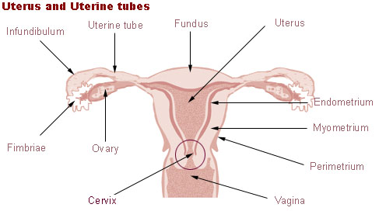
Ectopic Pregnancy
2% of all pregnancies
Most common in
  ampulla >> isthmic>others
Heterotopic
  1 in 4000 to 10000
  IVF = 1/1000-1/2000
T1 Bleeding + Abdo Pain = 10% Ectopic

Slide 4
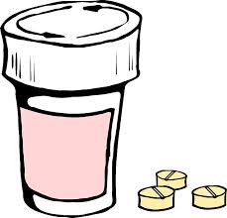
When NOT to give Abx for Dog Bite
Crush injury
Extremity injury
Puncture wound
If wound is sutured closed
Asplenic patient

Slide 5
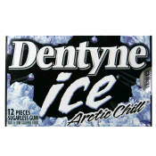
Did you say Dentyne?
Enamel:
  hardest substance in body
  Protects the crown
Dentin:
  Core structure of the tooth, bone-like material
Pulp Chamber
  Contains blood vessels and nerves that connect to neurovascular supply of jaw
Notes:
cementum

